Slide 1

RATIONALE STATEMENT
> We have a dataset Happy_Dataset.cvs in which there are 143 observations, 6 independent variables and 1 dependent variables. Variables are as follows:
Independent Variables: X1 = the availability of information about the city services
X2 = the cost of housing
X3 = the overall quality of public schools
X4 = your trust in the local police
X5 = the maintenance of streets and sidewalks
X6 = the availability of social community events
Attributes X1 to X6 have values 1 to 5. Dependent Variable: D = decision attribute (D) with values 0 (unhappy) and 1 (happy) > Now we would like to create LDA and QDA Models for this dataset in order to forecast if the person is unhappy or happy.
> So, In order to forecast if the person is unhappy or happy we’ll be creating both models and according to that we can give insights for the same. Here, SMOTE will be used to fix any discrepancies in the dataset. We assume that the input variables should all have the same variance and that both the LDA and QDA classification models should have normal variance distributions.
> Also we’ll be giving the key insights for Pandas Profile Report and then we can compare both Optimized model and can identify which one is better.
> We’ll be recommending the ways for the next steps of the model in the end.

Slide 2
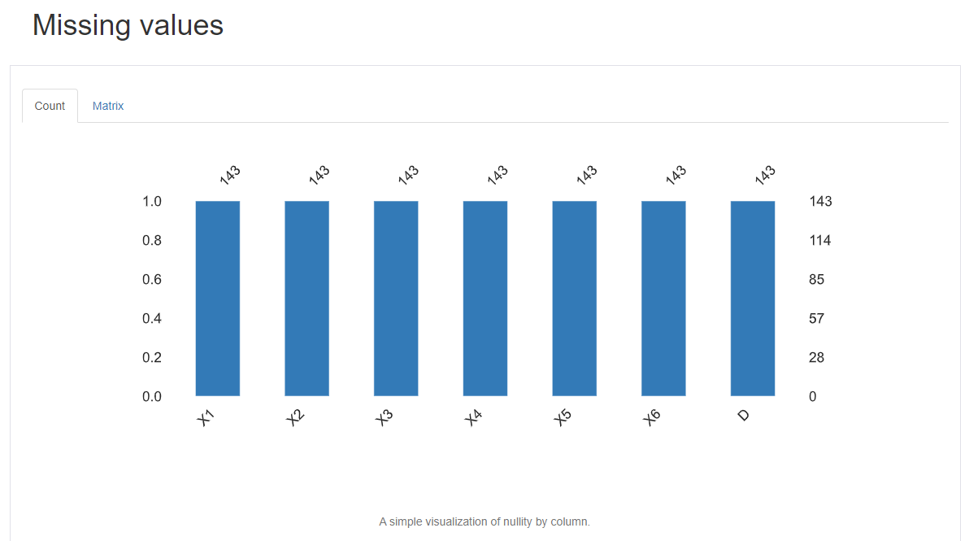
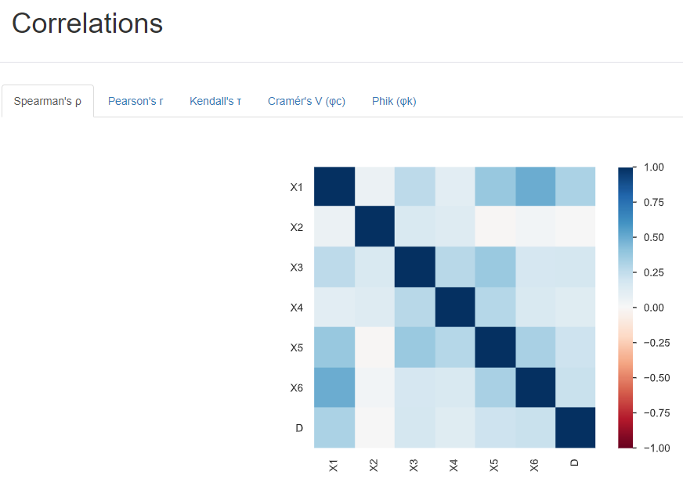
Pandas Profile Report
> From the Pandas Profile Report we can see the missing values count, so from the output, we can see that for all the variables the count is 143, which means there are no missing values. > From the report we conclude that variables X3, X4, X5, and X6 have High Correlations. Also, between the independent variables, there is a significant negative correlation.

Slide 3
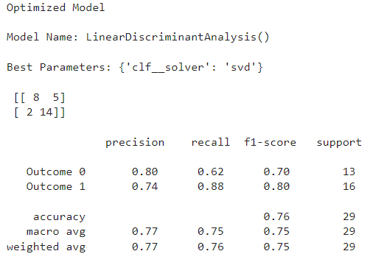
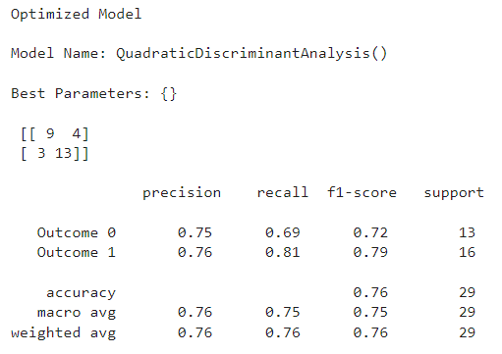
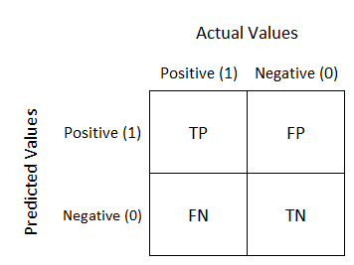
Confusion Matrix
> Confusion Matrix serves as a performance indicator for classification problems using machine learning where the output can include two or more classes. It is a table with four separate sets of actual and predicted values. > The Confusion Matrix from the LDA and QDA models are shown in the outputs.

Slide 4

Three Key Insights from the Report Metrics
Linear Discriminant Analysis (LDA) – Optimized Model Precision – Precision is calculated as the ratio of classified positive sample(i.e. True positive) to the total number of samples classified as positive(i.e. both True Positive and False Positive). Precision = True Positive / (True Positive + False Positive)
> Happy(1) has a Precision of 74%, whereas unhappy(0) has a Precision of 80%. This indicates that our model accurately identified 80% of the labels for unhappy outcomes and 74% of the labels for happy outcomes. Our Weight avg is 0.77 which means 77% is the total model precision.

Slide 5
Recall – Recall is calculated as the ratio of the number of True positive to the total number of positive samples.(i.e. both True Positive and False Negative). Recall is measured as the model’s ability to detect positive samples. Recall = True Positive / (True Positive + False Negative)
> Recall rates for unhappy(0) and happy(1) are respectively 62% and 88%. This indicates that the model correctly classified 62% of actual positives for the unhappy category, 88% of labels for the happy category. Our Weighted Avg is 0.76 which means 76% is actually positive which are correctly classified. F1 Score – Precision and Recall are the two building blocks of the F1 score. The goal of the F1 score is to combine the precision and recall metrics into a single metric. In simple words F1 Score is the combination of Precision and Recall. F1 Score = 2* ((Precision * Recall)/(Precision + Recall))
> The F1 scores for unhappy(0) and happy(1) in the provided dataset are 70% and 80%, respectively. The Weighted Avg for F1 Score is 0.75. As F1 Score is the combination of Recall and Precision this means overall our model is 75% correctly classified. And F1 Score is 75%.

Slide 6
Quadratic Discriminant Analysis (QDA) – Optimized Model
Precision – Precision = True Positive / (True Positive + False Positive)
> Happy(1) has a Precision of 76%, whereas unhappy(0) has a Precision of 75%. This indicates that our model accurately identified 75% of the labels for unhappy outcomes and 76% of the labels for happy outcomes. Our Weight avg is 0.76 that means 76% is the total model precision.
Recall – Recall = True Positive / (True Positive + False Negative)
> Recall rates for unhappy(0) and happy(1) are respectively 69% and 81%. This indicates that the model correctly classified 69% of actual positives for the unhappy category, 81% of labels for the happy category. Our Weighted Avg is 0.76 this means 76% is actually positive which are correctly classified. F1 Score – F1 Score = 2* ((Precision * Recall)/(Precision + Recall))
> The F1 scores for unhappy(0) and happy(1) in the provided dataset are 72% and 79%, respectively. The Weighted Avg for F1 Score is 0.76. As F1 Score is the combination of Recall and Precision this means overall our model is 76% correctly classified. And F1 Score is 76%.
> Also, When creating the QDA learning Curve. We receive a Warning - UserWarning: Variables are collinear warnings. warn("Variables are collinear") The above states that our variables are collinear as previously discussed.

Slide 7
Discriminant Analysis (DA)
> Discriminant Analysis (DA) is a classification technique that separates objects into two or more mutually exclusive groups (i.e. dependent variable) based on measurable features (i.e. independent variables) of those objects.
Types of Discriminant Analysis :
Linear Discriminant Analysis (LDA) It is used when a linear boundary is required between classifiers. It assumes the covariances are equal.
Quadratic Discriminant Analysis (QDA) It is used to find a non-linear boundary between classifiers. No assumption regarding covariances.

Slide 8
Comparison
LDA
QDA
Precision | In LDA the weighted average is 77% which is higher than that of 76% in QDA. Means in the above two model Linear Discriminant Analysis (LDA) is much more accurate than Quadratic Discriminant Analysis (QDA) . LDA is around 1% more accurate than QDA.
Recall | For Recall the LDA’s model weighted average is 76% and 76% for QDA’s model. So we can say both optimized models are performing equally.
F1 Score | The weighted average in LDA’s model is 75% and 76% for QDA’s model. Means Linear Discriminant Analysis(LDA) is lesser by 1% than QDA. We can clearly say that overall the output for Quadratic Discriminant Analysis is more accurate.
Conclusion | On comparing both the outputs for the given Dataset, we can conclude that both LDA and QDA are working accurately and efficiently. On comparing the above there is not much of a difference in the output. But still, we’ll recommend the QDA model as it is slightly more accurate by 1%.

Slide 9
Recommendations
> Cleaning the dataset should be done before performing any method on it. It will assist in removing errors and enhancing the accuracy of our product. For instance, deleting any independent variables that don't contribute to our results can help to improve precision and effectiveness. > Accuracy will be improved with more data and training because there is a lack of data, which could be the root of the problem. More accurate assumptions can always be made with the addition of more high-quality data.
> The model may interpret your data incorrectly as a result of missing values and outliers. Outliers and missing values should therefore be eliminated from the dataset in order to improve the model's precision and model prediction.

